Slide 1
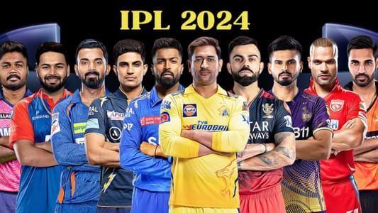
“IPL ANALYSIS”
Presented by;-
kiran mirje

Slide 2
Introuduction &objective :-
Problem Statement :-
ipl generates a large amount of match and player data every season. it is difficult to identify team performance trends, player effectiveness, venue impact, and match-winning factors without proper analysis.
Objective:-
Analyze IPL match and player data.
Identify top-performing teams and players.
Study the impact of toss decisions.
Evaluate venue-wise performance.
Generate insights for better decision-making.
Key Focus Areas:-
Team Performance Analysis
Player Performance Analysis
Toss Impact Analysis
Venue Analysis
Season-wise Trends
Match Result Patterns

Slide 3
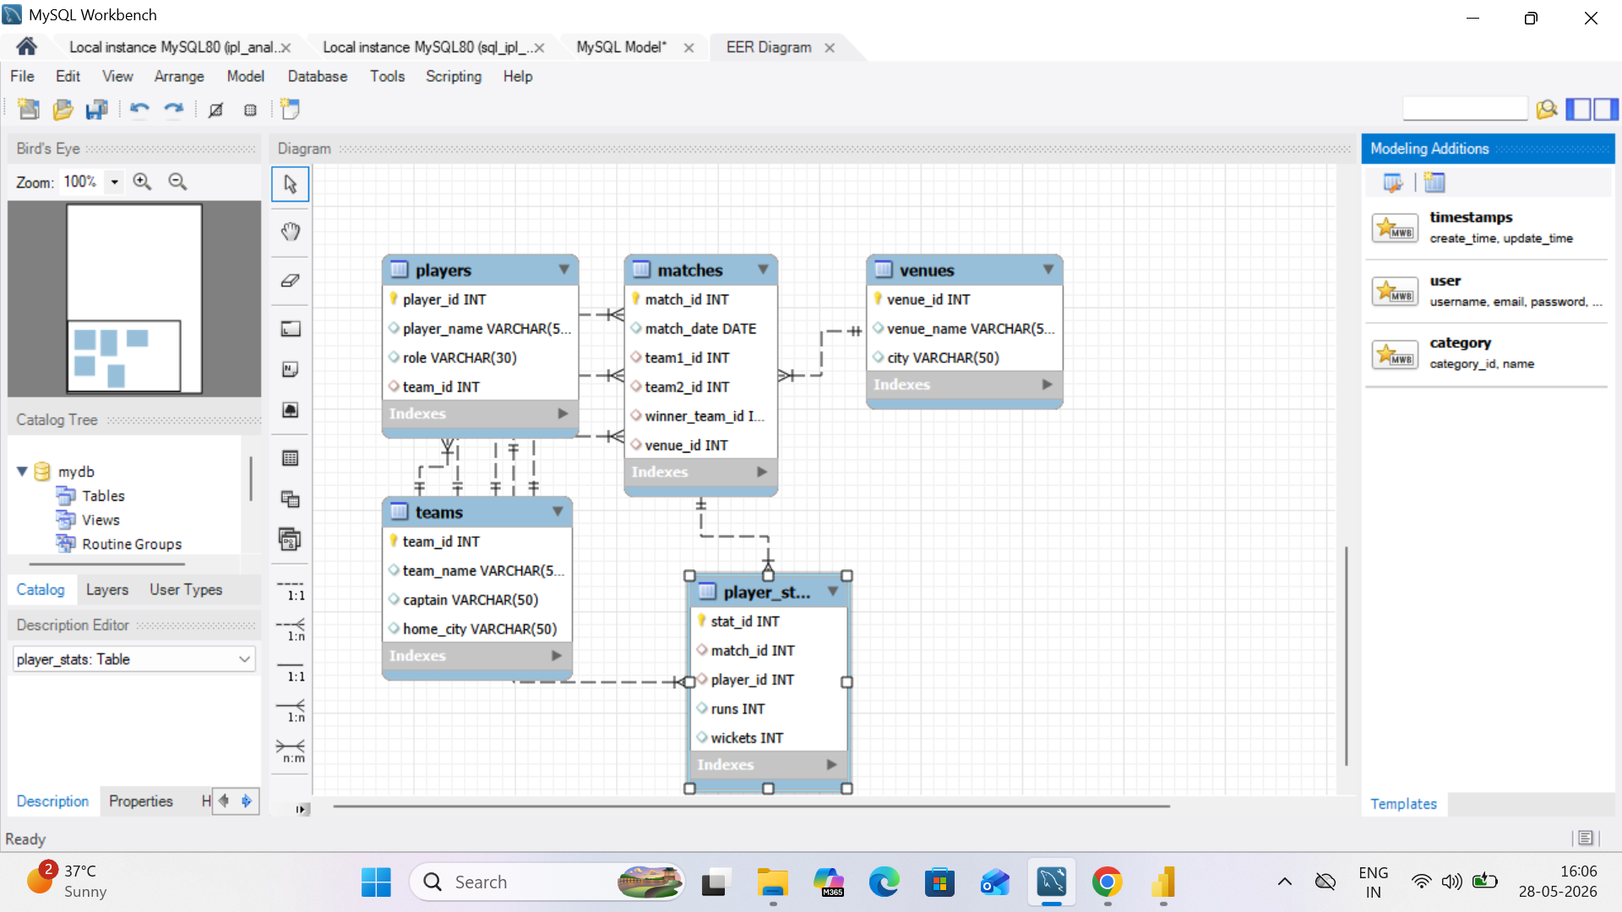

Slide 4
1. PTotal matches played
SELECT COUNT(*) AS total_matchesFROM matches;
2. Match winners with venue
SELECT m.match_id,t.team_name AS winner,v.venue_nameFROM matches mJOIN teams tON m.winner_team_id = t.team_idJOIN venues vON m.venue_id = v.venue_id;

Slide 5
(aggregate function queries)
3. total matches played
SELECT COUNT(*) AS total_matchesFROM matches;
4. total runs scored by each player
select p.player_name,sum(ps.runs) as total_runsfrom player_stats psjoin players pon ps.player_id = p.player_idgroup by p.player_nameorder by total_runs desc;

Slide 6
5.Total wickets by each player select p.player_name,sum(ps.wickets) as total_wicketsfrom player_stats psjoin players pon ps.player_id = p.player_idgroup by p.player_nameorder by total_wickets desc;
(Top Performance Queries)
6. ighest run scorerSELECT
p.player_name,SUM(ps.runs) AS total_runsFROM player_stats psJOIN players pON ps.player_id = p.player_idGROUP BY p.player_nameORDER BY total_runs DESC

Slide 7
7.highest wicket taker select p.player_name,sum(ps.wickets) as total_wicketsfrom player_stats psjoin players pon ps.player_id = p.player_idgroup by p.player_nameorder by total_wickets desclimit 1;
8. top 3 batsmen
select p.player_name,sum(ps.runs) as total_runsfrom player_stats psjoin players pon ps.player_id = p.player_idgroup by p.player_nameorder by total_runs desclimit 3;

